Slide 1
Understanding the Proposed
Data Center Ordinance
A community briefing on the proposed amendment to the Tooele County Land Use Ordinance
Tooele County
Notes:
Purpose of the briefing: educate the public on what the proposed data center ordinance does and why the County is considering it. This is an educational session — not the formal public hearing. The public hearings will be held before the Planning Commission and, later, before the County Council. Introduce yourself, the presenting staff, and any County Attorney or Community Development representatives present. Confirm the date and location of the next Planning Commission and County Council hearings before starting.

Slide 2
Why an ordinance, and why now?
Tooele County does not have a data center ordinance today.
Data centers are being proposed across Utah — including in and around Tooele County.
A quick reference
Without a specific ordinance, each application gets reviewed on a case-by-case basis under general zoning — creating uncertainty for residents, applicants, and staff.
200+
The proposed ordinance sets clear, published standards that apply the same way to every applicant, on every site, from day one.
Data centers built in Loudoun County, VA over 20 years — mostly under general “office park” rules that were never updated.
Getting the rules in place before an applicant submits an application gives the County the ability to shape outcomes, rather than react to them.
Tooele County has the opportunity to plan first, then permit.
Tooele County | Data Center Ordinance | Public Information
2
Notes:
Key talking point: Loudoun's experience is instructive. They approved data centers under general office-park zoning starting in 2000. By the time they updated their zoning ordinance in 2023, they had over 200 data centers built and 117 more in the pipeline. The community backlash was severe. Contrast: Tooele has the opportunity to establish standards before facility applications arrive — allowing the community to shape outcomes rather than react to them. Emphasize that this is not anti-data-center — it's pro-planning. Well-run facilities under clear rules can benefit the County; poorly-regulated facilities under no rules can hurt it.

Slide 3
Five purposes of the ordinance
What the text amendment is designed to do.
1
Set clear location and design standards
Data centers are allowed only in the Manufacturing General (M-G) zoning district. Every facility gets standards for setbacks, screening, height, and site design.
2
Require full disclosure of impacts
Water use, power demand, cost allocation, emissions, noise, and traffic must all be documented as part of the application — before decisions are made.
3
Protect neighborhoods and quality of life
Minimum 500-foot setback from residential (1,000 feet for hyperscale). Noise, lighting, and air-emission limits at the property line.
4
Ensure meaningful public review
Every data center facility requires a conditional use permit. No by-right approvals.
5
Plan for the end of the facility’s life
Decommissioning plan required with every application. Financial assurance in place before construction. Site cleanup covered if the facility closes.
Tooele County | Data Center Ordinance | Public Information
3
Notes:
This slide sets up the rest of the deck — each of the next several slides will go into more depth on one of these purposes. Don't rush this slide. This is where most of the audience will orient. Read each purpose aloud, then say: 'Let's take these one at a time.' Anticipate the question 'why five and not four or six?' — the answer is that these are the five principles the ordinance is organized around, and they map to the sections of Article 32.

Slide 4
Where data centers can be built
M-G
Manufacturing General zoning
The County’s heavy-industrial zoning district. Chosen because it already anticipates more significant water, power, and traffic uses; adjacent land uses are typically compatible; and it is located away from residential concentrations.
Review by: Planning Commission
No by-right approvals. Every data center facility requires a conditional use permit.
Tooele County | Data Center Ordinance | Public Information
4
Notes:
This slide addresses one of the most common public questions: 'Can a data center be built next to my house?' The answer is no — data centers are limited to M-G zoning or specifically-designated RSDZ Overlay areas. Emphasize 'no by-right approvals.' This means every application gets a full conditional use permit review with public notice and hearing. This is different from what Loudoun County had. For M-G locations: point to the North Tooele Valley industrial corridor and the areas around Rowley/Grantsville as examples of where M-G land exists today. Have a map ready for Q&A if possible. For RSDZ Overlay: emphasize this is a separate legislative process that itself requires public notice and hearing before any parcel is included.

Slide 5
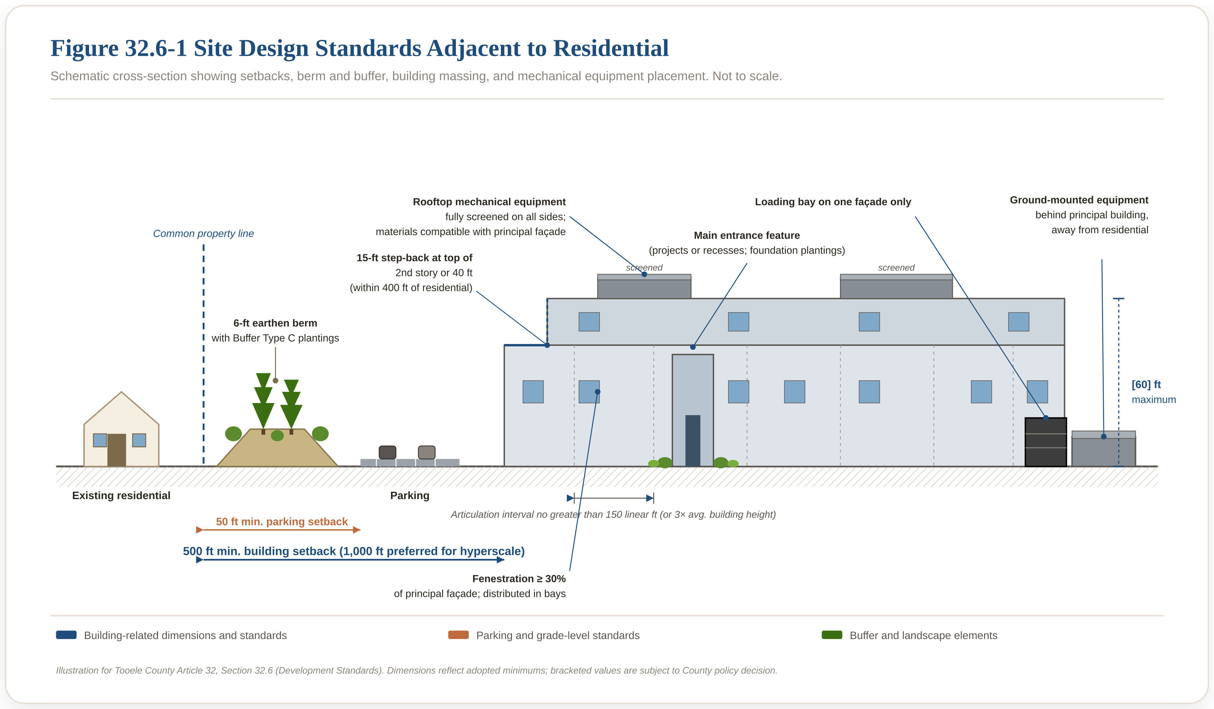
How facilities will look and fit in
Site design standards adjacent to residential property.
Key standards
500 feet
min. building setback from residential
50 feet
min. parking setback
6 feet
min. earthen berm with buffer
30%
min. fenestration of principal façade
50 dBA
day noise limit at property line
Tooele County | Data Center Ordinance | Public Information
5
Notes:
Walk through the figure. Start left with the existing residential property, then the common property line, the six-foot earthen berm with Buffer Type C plantings, the 50-foot parking setback, the 500-foot building setback, and the data center itself. Point out the building step-back at the second story — this prevents the wall-of-building effect close to the property line. The screened mechanical equipment and the single-facade loading bay location are both adaptations from Loudoun County's 2023 ordinance rewrite. The sidebar numbers are the five most-referenced standards. For hyperscale facilities (250 MW+), the preferred building setback is 1,000 feet — this is noted in the ordinance but not shown here to keep the figure readable. The 60-foot height limit is currently bracketed pending final County policy decision.

Slide 6
Full disclosure of resources and infrastructure
The County and the public will know the answers before decisions are made.
Water
Power
Projected use in gallons per day, per year, and per megawatt-hour. Water rights or will-serve commitment required. Cooling method disclosed. Conservation plan required.
Peak and average electrical demand disclosed. Utility service commitment required. Large-load customer arrangements disclosed. Cost allocation between the applicant and ratepayers disclosed.
Economic & Fiscal Impact
Roads and services
Applicant must disclose projected jobs, workforce commitments, and all requested public incentives, plus a 10-year net fiscal impact analysis comparing public revenues to public costs.
Traffic study required. Fire-protection and emergency-response capacity identified. County service impacts documented. Public infrastructure costs addressed through conditions of approval or lawful agreements.
Tooele County | Data Center Ordinance | Public Information
6
Notes:
This slide addresses the 'what will it cost us?' question. The ordinance does not stop the County from approving projects that require public investment — but it requires those costs to be disclosed BEFORE the decision is made. Water disclosure is critical in Tooele Valley given water rights are already limited. Applicants must show water rights or a will-serve commitment. Cost allocation: this is the provision that addresses stranded costs. If a project's infrastructure costs would fall on residential ratepayers, that has to be disclosed and comes into the fiscal analysis. The sales-tax exemption comparison item is important — under Utah's qualifying data center exemption (§59-12-102), a facility can claim a large state sales-tax exemption. Under H.B. 507 (2026), the County can impose an energy excise tax. The ordinance requires both to be projected side-by-side so the public can see the true net fiscal picture.

Slide 7
Protecting quality of life
Standards that apply at the property line and at the nearest home.
N
Noise
L
Lighting
50 dBA (Leq) day at the property line; 45 dBA at night at the nearest home. Both dBA and dBC measured. Pre- and post-construction studies required. Acoustic barrier required around mechanical equipment adjacent to residential.
Full cutoff, shielded fixtures directed downward. Security lighting held to the same maximum illumination limits. Night-time curtailment. Photometric plan required at application.
A
Air
T
Traffic and access
EPA Tier IV backup generators. Selective catalytic reduction on any natural gas turbine operating as baseload (NOx, PM2.5, and CO₂ all disclosed separately).
Traffic study required. Haul routes and access points reviewed. Road improvements attributable to the facility identified and funded. Construction management plan required.
Tooele County | Data Center Ordinance | Public Information
7
Notes:
This is the slide most residents care about. Walk through each of the four categories deliberately. Noise: the 50 dBA daytime property-line limit is comparable to a normal conversation. The 45 dBA nighttime limit at the receptor is stricter than most industrial ordinances in Utah. Both dBA (regular sound scale) and dBC (low-frequency sound) are required — this is important because data center noise complaints are often about low-frequency hum that a dBA-only measurement misses. Lighting: the security-lighting inclusion closes a common loophole where operational lighting complies but security floodlights don't. Air: this is where the ordinance is unusually candid. Selective catalytic reduction is required on any baseload gas turbine, but the ordinance explicitly acknowledges SCR doesn't reduce CO2 and can increase PM2.5 — because the public deserves accurate information, not marketing. Traffic: standard for any large industrial use, but explicitly required rather than left to case-by-case negotiation.

Slide 8
Multiple power options — all with disclosure
How data centers get their electricity, and what the ordinance requires.
1
Grid power
Traditional. Utility will-serve commitment and lead-time disclosure required.
2
On-site natural gas
Turbines with selective catalytic reduction, honest disclosure of NOx/PM2.5/CO₂. Continuous-operation noise modeling required.
3
Energy storage
Lithium-ion (BESS) held to NFPA 855 with thermal-runaway safeguards. Long-duration storage (LDES) permitted with technology-specific standards.
4
Nuclear (SMR / microreactor)
Land-use disclosure required: reactor type, fuel enrichment (LEU or HALEU), on-site waste storage plan, transportation coordination, federal agency coordination.
Tooele County | Data Center Ordinance | Public Information
8
Notes:
Address the nuclear question directly and honestly. Advanced nuclear (SMR and microreactor) is being seriously discussed for Tooele County through the Nuclear Lifecycle Innovation Campus project — the public will have this question, and it's better to answer it head-on than let it become a controversy in Q&A. The ordinance does not authorize the County to regulate nuclear safety — that's federal (NRC) authority. What the ordinance DOES do is require detailed land-use disclosure: what type of reactor, what fuel, what happens to spent fuel, transportation routes, and coordination with federal and state emergency management. The two diagrams are simplified illustrations to show the public what these technologies look like. SMRs are enclosed water-cooled reactors similar in principle to traditional nuclear but much smaller. Microreactors are even smaller units that use heat pipes instead of pumped coolant loops. Both diagrams are on the County's public information website with more detail.

Slide 9
Planning for the end of the facility’s life
The community is not left with the cleanup bill.
01
Before construction
Why this matters
Detailed decommissioning plan submitted with the application. Cost estimate prepared by a qualified professional acceptable to the County.
Data centers are large industrial facilities. When they close, the buildings, equipment, cooling systems, and fuel storage don’t go away by themselves.
02
Before occupancy
Financial assurance in place — bond, letter of credit, or escrow — in the full amount of the decommissioning cost estimate. Names the County as beneficiary.
03
Every three years
Cost estimate and financial assurance reviewed and updated. Reviewed again on transfer of ownership or on substantial modification.
The ordinance ensures financial assurance is in place before construction — not after the fact.
04
On abandonment
12 months of vacant operation triggers decommissioning. The County can use the financial assurance to complete the work if the owner fails to.
Tooele County | Data Center Ordinance | Public Information
9
Notes:
The public sometimes assumes decommissioning is a problem someone else will worry about. This slide makes clear the County is dealing with it up front. The financial assurance requirement is the key protection. It must be a bond, letter of credit, or escrow — not a promise. It must name the County as the beneficiary. And it must be in the full amount of the qualified professional's cost estimate. The three-year update is important because construction costs change; the assurance amount has to keep up. The 12-month abandonment trigger prevents a facility from being 'temporarily idle' for years while the buildings deteriorate. Common question: 'What about the salvage value?' — the ordinance allows the County to disallow salvage value in setting the assurance amount, because salvage value at closure isn't guaranteed.

Slide 10
How you can be heard
The public process for adopting the ordinance — and for every application after.
Step 1 — Adopting the ordinance
1
Planning Commission
2
County Council
3
Adoption
Reviews the proposed ordinance, holds public hearing, and forwards a recommendation to the County Council.
Reviews the ordinance and the Planning Commission recommendation and votes on adoption.
Ordinance takes effect on the date the County Council sets. Public information website is updated and the ordinance is codified.
Step 2 — Every future data center application
Written comment
Public hearing
Ongoing reporting
Any resident, adjacent property owner, or interested party may submit written comments during the notice period. All comments become part of the record.
Every facility, and every facility with on-site generation, gets a public hearing before the Planning Commission.
Approved facilities file annual compliance reports. The County publishes them. Residents can flag concerns any time.
Tooele County | Data Center Ordinance | Public Information
10
Notes:
This slide clarifies two distinct public processes that are often confused. Step 1 is the ordinance ADOPTION — the process we're in now. Public input matters here to shape the rules themselves. Step 2 is the process for every INDIVIDUAL APPLICATION that comes in after the ordinance is adopted. The ordinance guarantees a robust public process for every one — no by-right approvals. Emphasize that the annual reporting requirement means the public conversation doesn't end at approval. Every year, each approved facility must report actual water use, power demand, complaints, and compliance status. Those reports are public records. Confirm the specific dates for the Planning Commission and County Council hearings on the ordinance itself before this slide is presented.

Slide 11
Key dates and how to participate
Bring your questions, comments, and concerns.
Coming up
Three ways to participate
Attend
Planning Commission hearing
Come to the Planning Commission hearing or the County Council meeting.
July 22, 7 pm
County Council
Comment
August 18, 6 pm
Submit written comments to the County Community Development’s office at any time before the Council hearing.
Read
Visit the County’s public information website for the full ordinance text (growtooele.com / Data Center).
Tooele County | Data Center Ordinance | Public Information
11
Notes:
Bracketed dates on the left are placeholders — fill these in with the confirmed hearing dates before presenting. For the open house: consider holding at least two, one in Tooele and one in Grantsville or Stansbury Park, to make participation accessible to residents across the County. For written comments: provide both a physical address (County Manager's Office) and an email address. Comments become part of the public record. For the website: have the URL ready to share verbally. The website already contains the full ordinance text, FAQ, and educational pages on nuclear power, water use, and other data center basics. This is a natural point to pause for questions from the audience before the closing slide.

Slide 12
Thank you
Learn more. Weigh in. Help shape the outcome.
Public information website
Growtooele.com / Data Center
Draft prepared for public information. Materials subject to revision through the adoption process.
Notes:
Close by thanking the audience for their time and attention. Restate that this is the beginning of the public conversation, not the end. Invite specific questions from the audience. If a question can't be answered on the spot, commit to responding through the FAQ page on the website. Confirm the URL of the public information website verbally, and mention any specific hearing dates coming up. For open houses, staff should stay after the formal presentation to talk with residents one-on-one.

